Slide 2
Theory of Change Essentials
Isabel Vogel
info@isabelvogel.co.uk
10 March 2020

Slide 3
theory of change
Notes:
What is a “theory of change”?
Every programme is packed with beliefs, assumptions and, yes, theories about how change happens– the way humans work, or organisations or political systems, or ecosystems. These ‘theories’ can be conscious or unconscious and are based on personal beliefs and values, assumptions
From simplest relationships of cause and effect of our first ToCs… to more complicated ones that we try to design into programmes and projects.
Evaluators of social programmes in the 1970s began to encourage programme implementers to make explicit their theories, so that these could be looked at systematically to help assess them and make decisions.
Various approaches were developed, for example, the well known ‘logic model’, and then a more integrated approach called ‘theory of change’.

Slide 4
What is ‘Theory of Change’?
A systematic process of critical reflection to explore and explain how and why we will promote a series of changes, to reach a long term goal.
What do we think needs to change, for whom and why does it matter?
What does that mean for
the part we play, working
with people in
a particular context?
Notes:
A theory of change is essentially an explanation of how a group of stakeholders expects to reach a commonly understood long-term goal.
Two key question to address is:
1. What do we think needs to change, for whom and why does it matter?
2. What does that mean for the part we play in a particular context, with a group of people?
ToC is:
A structured approach to critical reflection, to underpin planning.
Places a programme, project or initiative within a wider analysis of how change comes about, and other factors and actors.
Makes us explain our understanding of change – but also challenges us to explore it further.
Integrates context and stakeholder analysis, with strategy design, monitoring, learning and adaptation.

Slide 5
Where does ToC come from?
‘Outcome chains’ and Logic Models adopted for planning and assessing social, education and development projects – co-existence of matrix vs. flexible formats continue to this day
Aspen Institute’s 1990s
initiative coined ‘theory of change’, applying programme theory to the evaluation of complex community initiatives and social change.
ToC as a collective process resonates with civil society organisations in development sector
1990s
1970s
1980s
2010s
‘Programme theory’ and ‘theory-driven evaluation’ become established concepts, e.g. Chen 1990.
Public sector management reforms in Canada and Australia create ‘boom’ in programme theory; the Log Frame comes to the UK.
2000s
International evaluation standards and practices established; ToC now a mainstream approach as evaluation refines approaches to testing and establishing causal linkages.
Ancient Greece
Epictetus writes “First say what you would be, then do what you have to do” – theory of intentional action
For more, see ‘Purposeful Program Theory’, Sue Funnell and Patricia Rogers, 2011
Notes:
Comes from the family of approaches in evaluation called programme theory.
ToC roots go back a long way, but popularised in the late 1980s and early 1990s by evaluators such as Huey-Tsyh Chen and Peter Rossi, Carol Weiss, Sue Funnel and Patricia Rogers, Michael Quinn Patton.
Comes from the family of approaches called programme theory, where the log-frame also comes from – the ‘theory’ refers to is that every intervention or programme is informed by a whole raft of ideas, assumptions and beliefs about how changes happens, why we are using particular strategies, and what we think the outcomes will be.

Slide 6
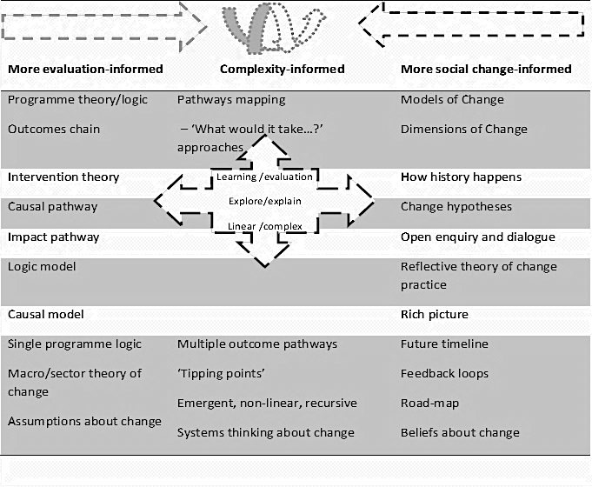
Where does ToC come from?
Adaptive management
Results chains
‘Theory of change thinking’
Adapted from James , 2011
Hivos
Notes:
ToC has become a mainstream approach but there hasn’t been any standardisation, perhaps as a push-back against other tools like, the log-frame, that are seen as too standardised and ‘tick-box’.
So many ideas and terminology have coalesced around theory of change, and different uses for different purposes, that this means that practice still varies considerably.
This slide attempts to map some of the diversity in purpose and approach.
Philosophically, ToC draws on ideas from evaluation, then more recently, it has become infused with Freirian ideas from social change and participatory traditions – about stimulating critical thinking to support activism. Freirian ideas and participatory approaches inform the process side of ToC practice.
Both traditions bring important aspects to ToC – evaluation tradition brings a systematic approach, logical thinking and drawing on existing lessons and evidence; Social change traditions bring reflexive practice, critical thinking about social structures and deep questioning of worldviews, values and assumptions inherent in development practice.
- So rather than a set methodology, it is better to think of ToC as ‘theory of change thinking’ – a structured approach that emphasises different elements depending on the purpose of the group working with it.

Slide 7
What is ToC really about?
Viewpoint 1:
ToC is an improved and more detailed logic model to better predict, plan and deliver results.
‘Log-frame on steroids’
Viewpoint 2:
ToC is a critical, participatory exploration of intentions, interests, values, power and gender relations, in order to contribute to social justice, equality, sustainable development.
‘What change, for whom, why - and who says so’?
Women working for Kaderes Peasant Development Ltd, Kayanga, Tanzania
© Jennifer Leavy 2016
Real change for real people in real life….
…including us!
Notes:
Perspective one is quite common, but it can get trapped in trying to map everything out and then control it. Tries to predict, which is risky in dynamic development environments, and if you’re not careful, it can become cumbersome and not very useful. Stick with the log-frame if this is what you need.
Perspective 2 is the one I subscribe to, it is more exploratory, to get the full value of a ToC approach. This supports individuals and organisations involved in change process to better understand the system they are part of, without over-simplifying to, in order to support change in a strategic, values-led and responsive way; and to learn from how the change process evolves in reality so that strategies can be reviewed and adjusted along the way.
This version also has explanatory power, sometimes more so than the very detailed version, and encourages a deeper questioning of the assumptions that permeate development, and so can be more robust
For me, the essence of ToC is to keep us thinking critically about the CHANGES that matter to the people that matter, in their contexts and lives:
who we are hoping to change things for,
what positive change means for them, in their lives
where change needs to happen in different domains to realise it – policies, practices markets, institutions, and more deeply in social relationships and norms,
finally, what our contribution to that change process might be.
ToC asks us to start our thinking from the perspective of real people, then using systematic critical thinking to move back towards what our contribution to change might be, to continuously question our assumptions, especially deeply-held and hidden ones.
You do need to think be precise, rigorous and logical in your process to get ToC quality, just because it is reflective does not mean it is vague.
Don’t forget to put yourself in the picture – we need to change as much as everyone else, we are not somehow ‘outside the system”.

Slide 8
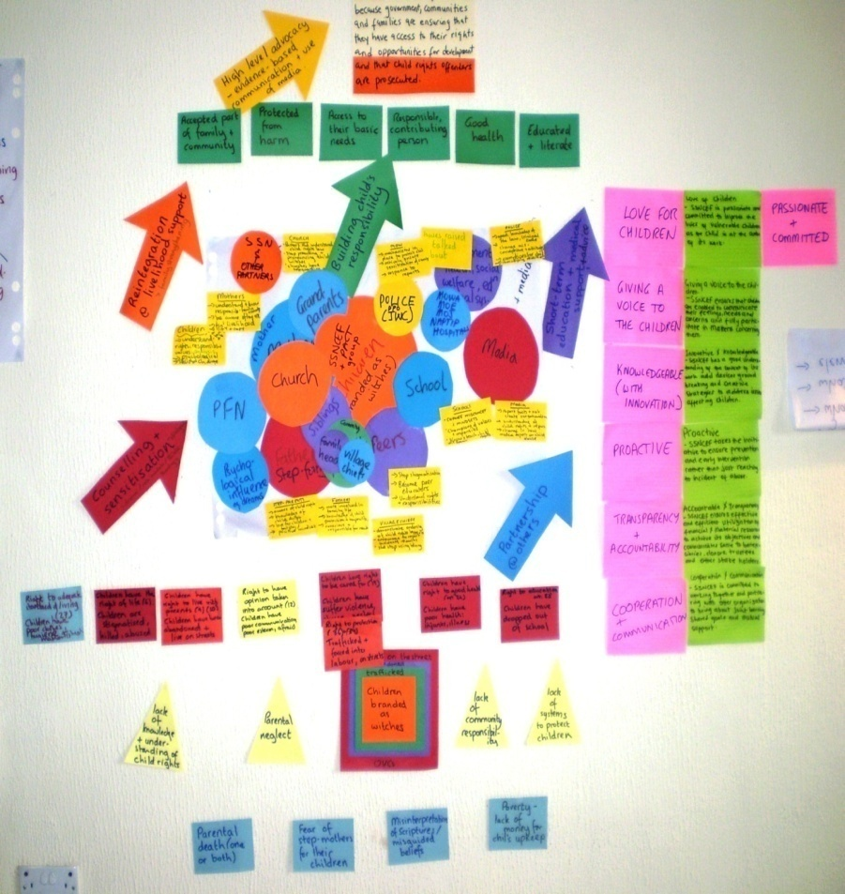
ToC - three aspects
Critical thinking about change - overall approach
Systematic process - group-based ToC critical analysis
Set of products - narratives, change pathway diagrams
Wide participation and ownership
Comprehensive analysis
Active use

Slide 9
Why ToC?
Avoid implementing a mistake!
Notes:
Avoid implementing a mistake!
Why it’s important: to develop a shared, explicit understanding of how things are understood to change, how the intervention will engage to support certain changes and/or inhibit others, what steps are involved, what assumptions are being made about this and what rationale we have for how and why change will happen the way we hope it will.
Once we can draw it out, we can test it, while it is still on the drawing board.
TC challenges you to define what you’re trying to achieve, how and why.
- Questions the underlying logic of how planned interventions will promote change – while it’s still on the drawing board, e.g.
What’s outside our control that could impact on it?
Is this intervention enough to realise the goals, what else is needed?
Do we have the resources, finances and skill sets we need to implement this?
Do we have any evidence that this intervention is effective? What innovations or alternatives should be aware of?
Helps the group to develop a realistic picture of the complexities and multiple stakeholders and processes involved in promoting the long-term change, and what is within their scope to influence.
Creates an opportunity to critically reflect on “what we really mean?”, and “why do we think that (assumptions)?” helps to strengthen vague and fuzzy concepts that we often take for granted, e.g. community empowerment, what does this look like in the settings we are working in?
Helps to clarify what change we are hoping to promote, how we will know and how we will track it, how much of it are we looking for, how will we adapt our project to what we’re observing – so ToC builds in Monitoring, evaluation and learning, and a focus on real change.
Using a group discussion process builds a shared understanding amongst implementers, participants and stakeholders of what they are trying to accomplish, as the basis for a clearly thought out plan and implementation.

Slide 10
An assumption is …
What we think is true or accepted as true
shaped by values, beliefs, experiences, education, profession
often implicit
often subjective
Theory of change is a structured process to examine our assumptions and make them explicit.

Slide 11
A common theory of change?
Information is provided
Awareness and knowledge is raised
People change their behaviour (the way we want them to)
What else might prompt change?
But people don’t usually act on information…?
What else is going in their lives?
Why would they? Why should they?
Notes:
Think about a time when you changed something in your life, did it happen like this?
Once you start to think about this, it‘s one of the most common theories underpinning so many initiatives.
How can we make this ’theory’ more useful?
E.g.
What assumptions are being made in this ’theory’?
What do we know about what makes people change their behaviour?
What else could we put in this ToC to make it more useful?

Slide 12
ToC elements and process

Slide 13
ToC =
Visual
Narrative
PMEL
frameworks
Plan to improve ToC
Products
Process
Situation-specific process of steps, using diverse ‘tools for thought’ with relevant people
Programme design
Strategy revision
Quality check
Evaluation / strategic learning design
Purposes
Comprehensive analysis
Power, gender lenses
Assumptions central
Participation in ToC development
Used actively
Principles
Van Es, Guijt and Vogel 2015
Notes:
- In 2015, I worked with Irene Guijt and Marjan Van Es to develop a practical guide to using ToC for complex programmes for Hivos, the Dutch human rights NGO. Our aim was to provide a structure for people to follow but without falling into tick-box thinking.
- Hivos Guide is available for free online, links at the end of this presentation.
We broke out four building blocks to ToC:
A set of core principles;
Being clear about your purpose for working with ToC, as a clear purpose informs…
An appropriate process, with the right stakeholders
Effective ToC products: visual, narrative, but also the PMEL frameworks, and a plan to improve the ToC continuously.
ToC works well as an over-arching process, as you can use different methods and tools in a ToC process, depending on requirements or own preferences.
Principles:
comprehensiveness of analysis (context, values, strategy, actors)
in-depth power and gender analysis about ‘how change happens’ and the forces that help and hinder
making explicit underlying assumptions and values, including about power and gender dynamics
participation of different groups of key people in ToC development
active and dynamic use in organisations to guide the work

Slide 14
Spheres of Influence for ToC
Sphere of direct influence - changes we promote and acheve, e.g. knowledge, skills and behaviour
Sphere of indirect influence: Intermediate changes we influence e.g. capacities, systems and practices
Sphere of interest - longer term changes we contribute to
Sphere of control: what we do with whom, how they respond and react
Awareness, knowledge and skills
Stakeholder
Capacities
Project / programme long term outcomes…
Over time contribute to…
Local partners
Responses
What we do with whom
Stakeholder
Community members
Alliances, networks, relationships
Reactions
Systems
Service providers
Reasoning
Stakeholder
Attitude and behaviour change
Practices
Impact – sustained positive changes in people’s lives, their communities and livelihoods, institutions and systems, and the physical environment
CHANGING CONTEXT
Notes:
This is a helpful framework for mapping out a ToC.
Spheres of influence
- A framework that we have found to be very useful for programmes is the concept of the spheres of influence.
Spheres of influence developed by the Canadian International Development Research Centre. It is also used specific applications of ToC, e.g. Outcome Mapping, which some of you may have seen.
It is part of IDRC’s frame for assessing research impact, but it is useful to unpacking any change process.
Sphere of control is everything that is in the control of the programme – portfolios of activity ,bringing resources, delivery partnerships, production of outputs (although it can still feel a bit uncontrolled!) There are reactions, responses and changes in reasoning that arise in participants via engaaing with the activities of the programme.
- Sphere of direct influence is where the programme’s efforts influence participants’, and possibly their immediate stakeholders’, awareness, knowledge and skills; attitudes and behaviours, networks and relationships.
Sphere of indirect influence is where those who were reached in turn go onto influence stakeholders within their wider networks.
The further we move away form the sphere of control towards the longer-term outcomes, control and influence diffuses because of the interaction of multiple actors, agencies, and socio-political circumstances. Definitely non-linear, and sometimes messy and complicated!
Sphere of interest (or impact) – is where the longer term goals and impact are placed, to act as guiding lights for all our analysis, planning and implementation.
The concept of the spheres of influence helps to illuminate what we can be held accountable for, as we have some measure of control and influence, and what is more challenging because it in the hands of others. However, we can all be held accountable for thinking this all through properly, while it is on the drawing board, to optimize the chances of promoting the changes that we want to see for the people we want to support.

Slide 15
What have we learned about working with ToC?

Slide 16
Insights into ToC at different levels
Conceptual and generic-
‘domains of change’
Worldview
Personal beliefs and understanding of how change happens and why
Worldview
Social, political theories and development perspectives informing thinking and action
Organisational-level ToC or Global ToC
Vision, mission, organisational values, strategic and operational preferences, and goals for social change
Country ToC for specific policy domain, issue area, system or sector
How a team expects change to evolve in a specific domain, why and how, its own role and contribution
Project or programme theory of action
How a team expects change to unfold as a result of implementing a portfolio of activities in a specific context, contributing to longer-term social change. Relates to thematic or organisational ToC.
Realistic and specific – ‘pathways mapping’
Van Es, Guijt and Vogel 2015
Notes:
One of the big challenges for using ToC is finding the right process and level of detail for the purpose and level of ToC.
We’ve got better at understanding ToC thinking at different levels, and what’s required in terms of process and level of detail.
So, before you start, you need to understand what level you are aiming to develop – if starting at an organisational level, or very conceptual, it will be challenging to define the pathways, there is simply too much information. It can get exhausting and overwhelming.
Better to sketch about broader, conceptual, ‘domains’ of change, e.g. policy areas, high-level outcome areas, or sector-wide systems, which can act as frameworks for ToC at more specific levels.
At a country and project level, it is where ToC really comes into its own – context analysis – real issues, real people, real environmental, institutional, market systems. Much more meaningful and relevant to track emerging change that can inform programme adaptation.

Slide 17
Step 2. Describe desired change
Step 4. Identify who/what/where needs to change
Step 7. Define MEL priorities and process
Step 8. Use ToC for critical reflection to implement and adapt
Step 3. Analyse current situation
Step 5. Strategic priorities
Step 1. Clarify purpose for using ToC
Step 6. Map change pathways
Theory of Change Elements
Notes:
Hivos developed a key questions driven, step-wise approach that follows established ToC practice, with additional steps for clarifying the purpose for working with ToC, developing MEL process and to ensure that the ToC is used.
– link in the slide deck hand out

Slide 18
Tips for a good ToC process
Purpose Be clear about the purpose and why you want to work with ToC – and design accordingly
Appropriate participatory process - step outside boxes
Wide participation and ownership
Gender and power analysis
Explicit, specific and robust
Comprehensive analysis
Who needs to be involved – staff, leaders, stakeholders
Assumptions and values
Contexts, actors, strategic options – analysis & research
Accessible, honouring complexity
Critical and useful – help to inform choices
Guiding implementation and adaptation
Visualisation & narrative
Different products for different audiences
Active use
Monitoring, evaluation & learning
Notes:
Purpose first.
Ownership & Participation: decide who need to be involved, consider how to include stakeholders, through appropriate processes.
Small groups – easier to get into a room but you still need to engage leaders and implementing staff for ownership and because the ToC might make you need to change ways of working, you’ll need.
Large groups – plan for a staged process, you can have a preliminary process where the task group gathers views via surveys or interviews, and constructs a Version 0 of the ToC. This can then be brought to the larger group via a workshop for challenging and development. After the workshop, the task group and facilitator compiles the material and creates V 1. Feedback and clarification can be sought via email and calls, to produce a V 2. A workshop can be convened again to validate V2 through a collective process, or some other appropriate validation process can be designed.
Use facilitation and participatory approaches to help people to step outside their boxes and get depth with their critical thinking.
Helpful to align with an existing review process, maybe strategy refresh or annual planning, so that people are primed to take a step back form day-to-day work. Also, there may be a window of opportunity to introduce changes in ways of working, if the ToC exploration identifies that your own practice needs to change to achieve the goals you seek.
Comprehensive analysis: Make sure that you are drawing on analysis, research and lessons, where possible, about the context etc and integrating a gender and power analysis – vital if you hope to promote equitable change and do no harm.
Assumptions: These must be central, and they must be interrogated fully, do not leave them vague and ‘lazy’, make them clear, focused on specifics and prioritise the most critical ones that help explain and guide choices.
Visualisation and products: The process of synthesising all those discussions into visuals and narratives is a key part of ToC. Keep involving the group in the visualisation to make sure it retains meaning and resonance, don’t let a graphic designer take it away, encourage the designer to engage too.
You will need different products – visualisations for exploration and planning will be different to those tailored for external communications – more detailed vs more summarised - so plan accordingly.
Active use: Make sure that the ToC stays actively used and is regularly reviewed and revised to maintain relevance and to incorporate learning. It is good practice to evolve the ToC. E.g. do a ToC review as part of the annual strategy and planning process, so that learning from the previous phase is gathered in a structured way along the ToC, esp testing assumptions and identifying new ones - and provides a robust foundation for planning for the next phase.

Slide 19
Notes:
- UK Government’s Large scale, long-term research and innovation fund, about £1.5 billion, spanning multiple UK research councils and research institutions, and global footprint.
Purpose: GCRF has a companion evaluation, ToC needed to guide that and frame learning and adaptation form innovation.
Process: initial workshop with 30 senior stakeholders and independent experts, to explore ideas about research and innovation impact – how change happens, pathways, the rationale behind the design of GCRF.
Asked to nominate a Technical Working Group, about 8 individuals who were focal points for their organisations. Asked them to sign up to 3 x 2 hr workshops over 3-4 months.
Analysis: The evaluation team developed the V0 – based on literature review of models, review of UK research impact case studies, evaluations of UK research, interviews and expert review – so developed a generic model – visual and narrative, assumptions explicit at each stage.
- Visual used Lucidchart free online diagramming software.
Ownership: Convened a TWG workshop, about 2 hrs, to discuss V0, then developed V1, feedback over email, developed V2, then convened TWG workshop to finalise. TWG brought their stakeholders’ views and concerns to feed in. Had planned a senior validation workshop, but TWG felt it was unnecessary, we could obtain sign-off by proxy, facilitated by TWG with their seniors.
We developed a few key questions for seniors to provide feedback on – esp if they cold see their work reflected in the ToC.
Obtained sign-off from all UKRI partners, and others, and positive feedback on the ToC – good ownership from focal points, and coordinating body.
Visualisation: Then worked with a graphic designer to fine tune the visual, and refined the narrative. Assumptions not possible to show in the diagram, but explicit in the narrative. Produced a summary narrative for external comms.
Active use: The evaluation was designed based on this, and the plan is to review the ToC in 2 years at mid-point of the fund.

Slide 20
Thank you for listening!

Slide 21
Resources and acknowledgements
This presentation builds on work produced collaboratively by Isabel Vogel, Irene Guijt (Learning by Design), Marjan Van Es (Hivos) and Maureen O’Flynn (independent consultant).
Please contact Isabel Vogel info@isabelvogel.co.uk if you wish to reproduce any of it.
Further reading:
Hivos Theory of Change Thinking in Practice: A Stepwise Approach, Van Es, M. I. Guijt, I. Vogel, (2015)
https://knowledge.hivos.org/theory-change-guidelines
Theory of Change for Organisations, A. Kellet (2017)
https://www.bond.org.uk/sites/default/files/resource-documents/organisational_theory_of_change_bond_10.pdf
Review of the use of Theory of Change in international development, DFID, I. Vogel, I (2012), https://www.gov.uk/government/news/dfid-research-review-of-the-use-of-theory-of-change-in-international-development
ESPA Guide for Researchers to Working with ToC, Vogel, I. (2011)
http://www.espa.ac.uk/files/espa/ESPA-Theory-of-Change-Manual-FINAL.pdf
Theory of Change, A Guide for Small and Diaspora NGOs, C. James (2010)
https://www.intrac.org/resources/theory-change-guide-small-diaspora-ngos/

Slide 23
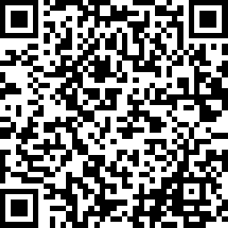
What did you think of today’s webinar?

Slide 24
Alliance Members’ Training Fund
Bursaries of up to £250 available to members with income >£250,000
Designed to help organisations access training/CPD events from external providers
Training courses/events can be in-person or online
Focused on any topic that helps you deliver on your organisational aims (e.g. fundraising, project management, reporting on outcomes, effective comms.)
Can cover training fees and other expenses associated with participation
For more info on eligibility and how to apply, visit: https://www.intdevalliance.scot/member-services/training-and-e-learning/members-training-fund

